Slide 1
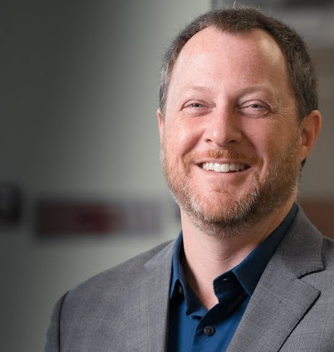

Biochem 3BP3 Practical Bioinformatics in the Genomics Era
Dr. Andrew McArthur (Prof)
Kara Tsang (TA)

Slide 2
Practical
Bioinformatics
Genomics

Slide 3
Practical
Bioinformatics
Biological Data | Computer Science | Math | Engineering | Statistics
Genomics

Slide 4
Practical
Bioinformatics
Biological Data | Computer Science | Math | Engineering | Statistics
Genomics
DNA | RNA | Sequencing Data | Genomes

Slide 5
Practical
Problem-Based Learning | Real Experimental Data | Hands-On
Bioinformatics
Biological Data | Computer Science | Math | Engineering | Statistics
Genomics
DNA | RNA | Sequencing Data | Genomes

Slide 6

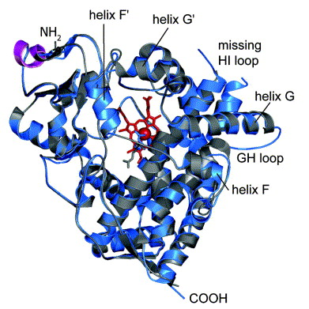
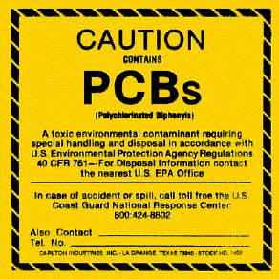
For Example…
Two weeks from now…
Annotation of the toxicological defensome of a Shark

Slide 7
For Example…
Before Reading Break…
Process sequencing data using the command line

Slide 8
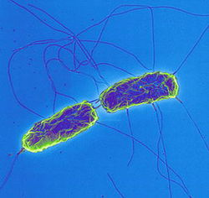
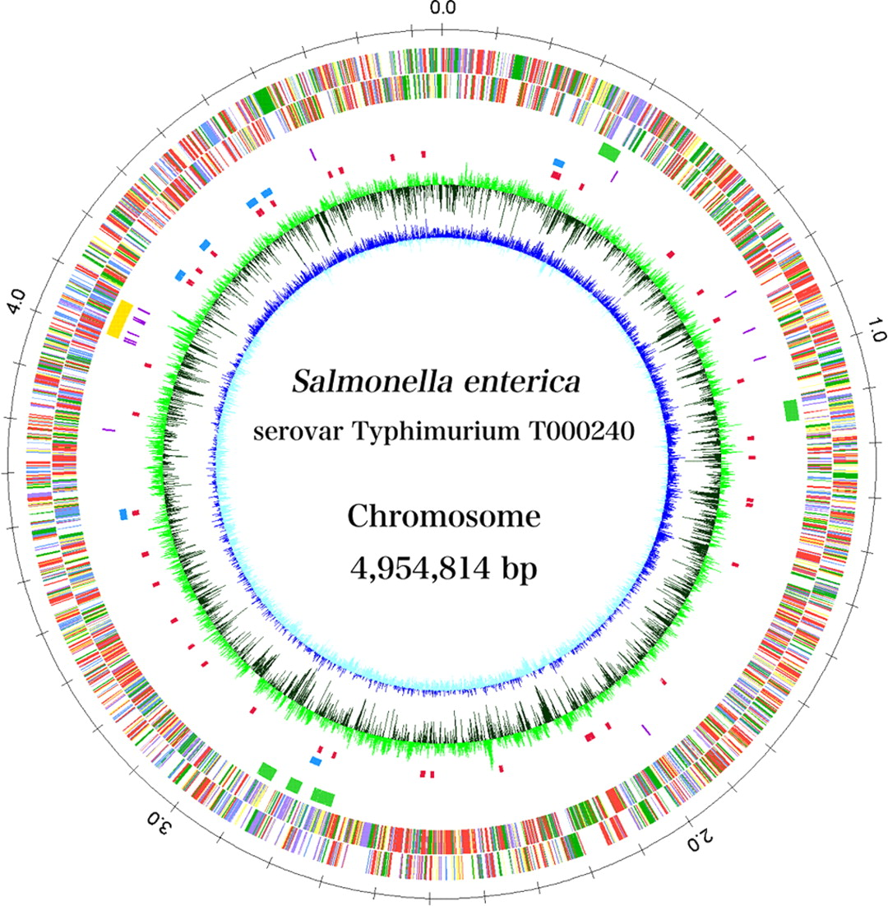
For Example…
Early November…
Use genomics to analyze a pathogen outbreak

Slide 9
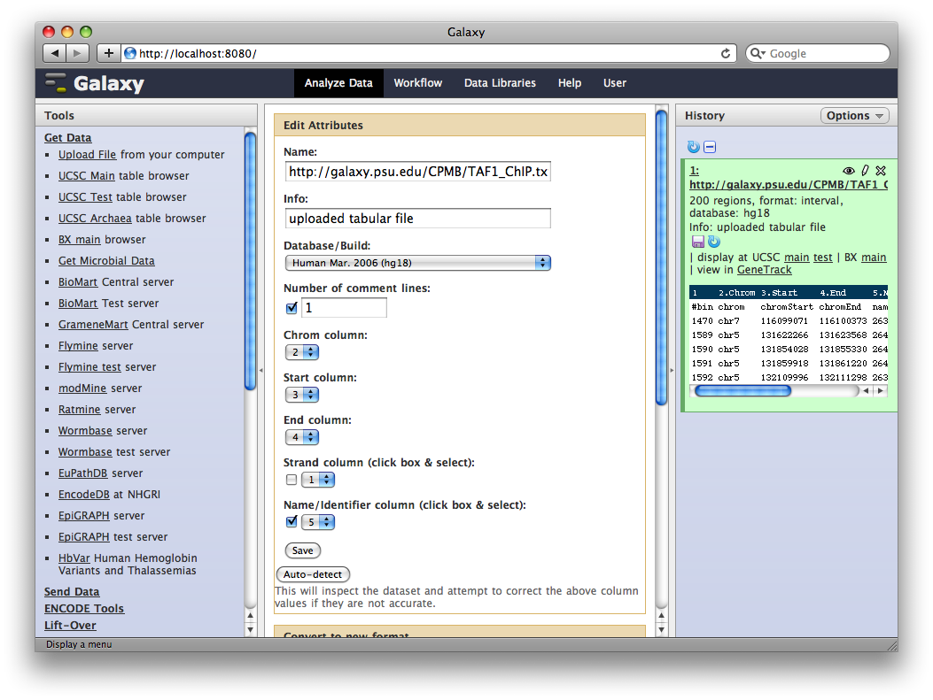
For Example…
By the end of November…
Use cloud computing to analyze gene expression data

Slide 10

No Computer Science Experience Required
Registered students are from Biochemistry, Biomedical Discovery & Commercialization, Arts & Sciences, iSci, Biology
The course goal is to teach you the theory and practice of analysis of real world research data in the biological / biomedical sciences.
The course will provide an introduction to Bioinformatics plus expand your research toolkit.

Slide 11
Course Structure
Weekly Modules - Mondays
Traditional lecture to introduce the topic and outline the key objectives
Overview and (optional) readings available in GitLab: https://github.com/agmcarthur/Biochem-3BP3

Slide 12
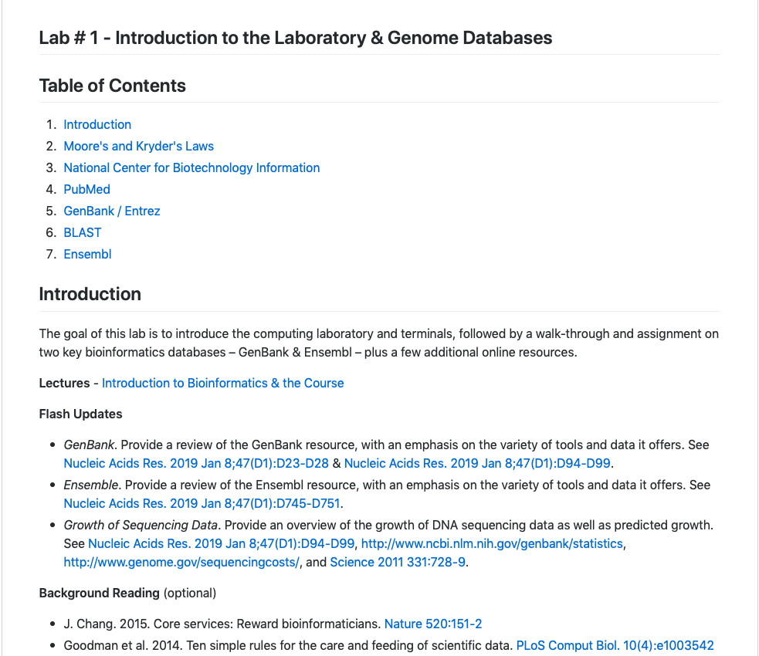
Course Structure

Slide 13
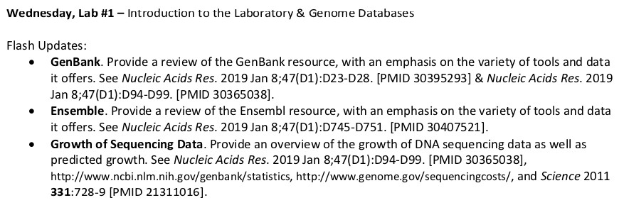
Course Structure
Weekly Modules – Wednesdays
Lab - 4 hour Problem-Based Learning Session (with break)
A core assignment due on Avenue to Learn (deadline varies)
3 students give a 10 minute “Flash Update” presentation each week
Course Schedule is on Avenue to Learn:

Slide 14
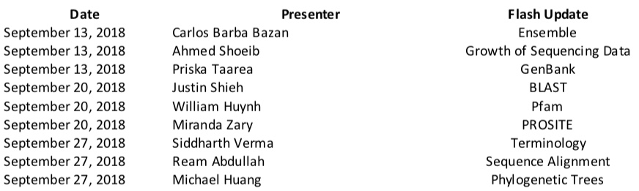
Flash Updates
Course Schedule is on Avenue to Learn
A Flash Update is a 10 minute PowerPoint presentation summarizing the key points of the assigned topic
PowerPoint file must be uploaded to Avenue to Learn by start of lab on Wednesdays!
UPDATE

Slide 15
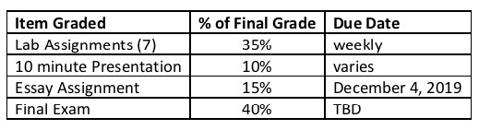
Course Structure
Course Outline & Marking Rubrics are on Avenue to Learn:
No textbook – primary literature only
Kara is available by appointment – see her first!
All work submitted via Avenue to Learn
Late penalty of 10% per day (grade of zero after 4 days)
Use McMaster Student Absence Form for absence less than 3 days
Final exam covers the entirety of the course; multiple choice questions

Slide 16
Andrew
Undergraduate in Ecology & Evolution (UWO)
PhD in Deep-Sea Biology (UVic)
Post-Doc at the Smithsonian Institution (Washington, DC)
Faculty at the Marine Biological Laboratory (Woods Hole, MA)
Left academia in 2006 – 10 years in the private sector with my own Bioinformatics company
Joined McMaster in late 2014 as the Cisco Research Chair in Bioinformatics
Sequenced the Giardia lamblia genome, leads the Comprehensive Antibiotic Resistance Database
Kara
Undergrad degree in Biomedical Discovery & Commercialization
PhD student in the McArthur Lab – Drug Resistance Analytics
MacDATA Institute Graduate Fellow, OGS Award, etc.

Slide 17
A ‘Living’ Course
Each term – evolving lectures, data, tools
Problem-Based Learning, Inverted Teaching Style
Real Experimental Data
Not everything is going to go perfectly
Experimental data is messy – there may not be an “answer”
The schedule is tentative
The 5% in-class assignments are tentative, some may be converted to participation marks
Being Successful
Attend all Labs & Lectures
Ask questions and use your Teaching Assistant!
Keep up with Reading Assignments – Lectures & Flash Updates

Slide 18
Questions about the Course?

Slide 19


A few things…
Avenue to Learn is central to the course – handing in assignments, schedules, Flash Update powerpoints, Lecture powerpoints, lab assignment downloads, etc.
All readings can be found on PubMed via a McMaster IP address or via the McMaster LibAccess portal if off campus: https://libraryssl.lib.mcmaster.ca (E-Journals)
LibAccess and A2L cannot be accessed from off-campus unless you use the Virtual Private Network: http://www.mcmaster.ca/uts/network/vpn/
KTH B121 computers will automatically log you out after 10 minutes of no mouse movement – deleting all your work. Use Caffeine, but remember to log out!

Slide 20

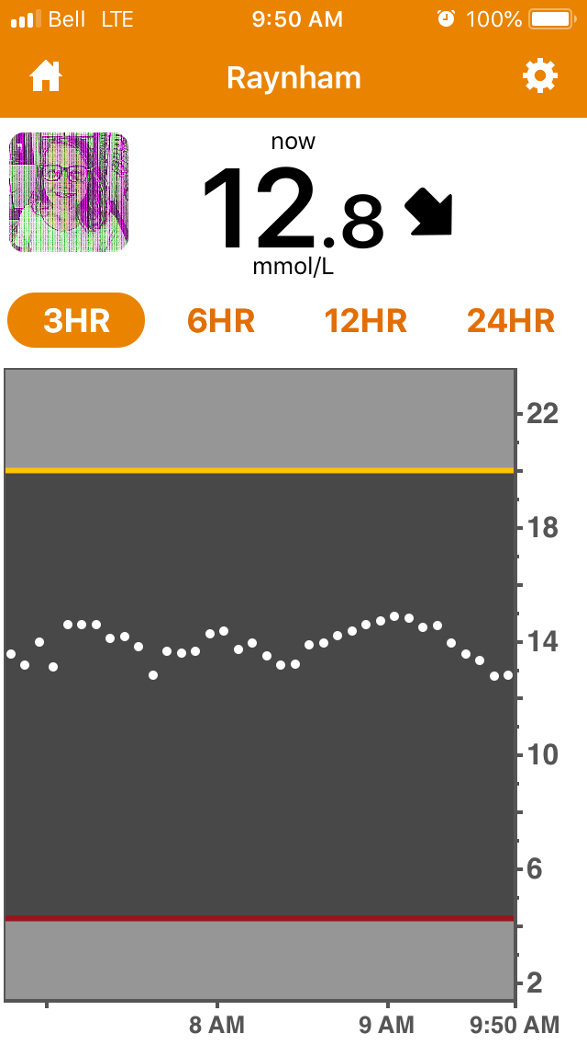
A few things…
Officially – no food or drink in the lab.
Unofficially – be discrete and neat, eat in the hall during breaks.
Let me know if we need a break!
Unexpected interruptions may happen!

Slide 21
Using PubMed

Slide 22
Using PubMed

Slide 23
Using PubMed

Slide 24
Using PubMed

Slide 25
Using PubMed

Slide 26
Bioinformatics
Application of mathematical, statistical, and computational approaches to biological data
Modern emphasis (and emphasis of this course) is upon genomic data, dominated by DNA sequencing.
Yet, bioinformatics is very broad & diverse, for example:
chemoinformatics
protein structure, prediction of ligand binding
whole cell simulation
evolutionary biology
assay development
analytics and machine learning
J. Chang. 2015. Core services: Reward bioinformaticians. Nature 520:151-2.

Slide 27
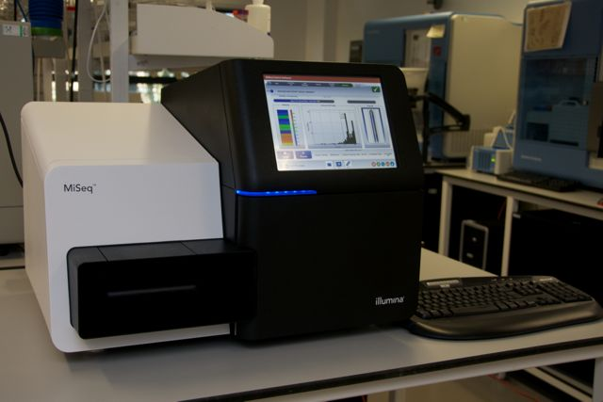
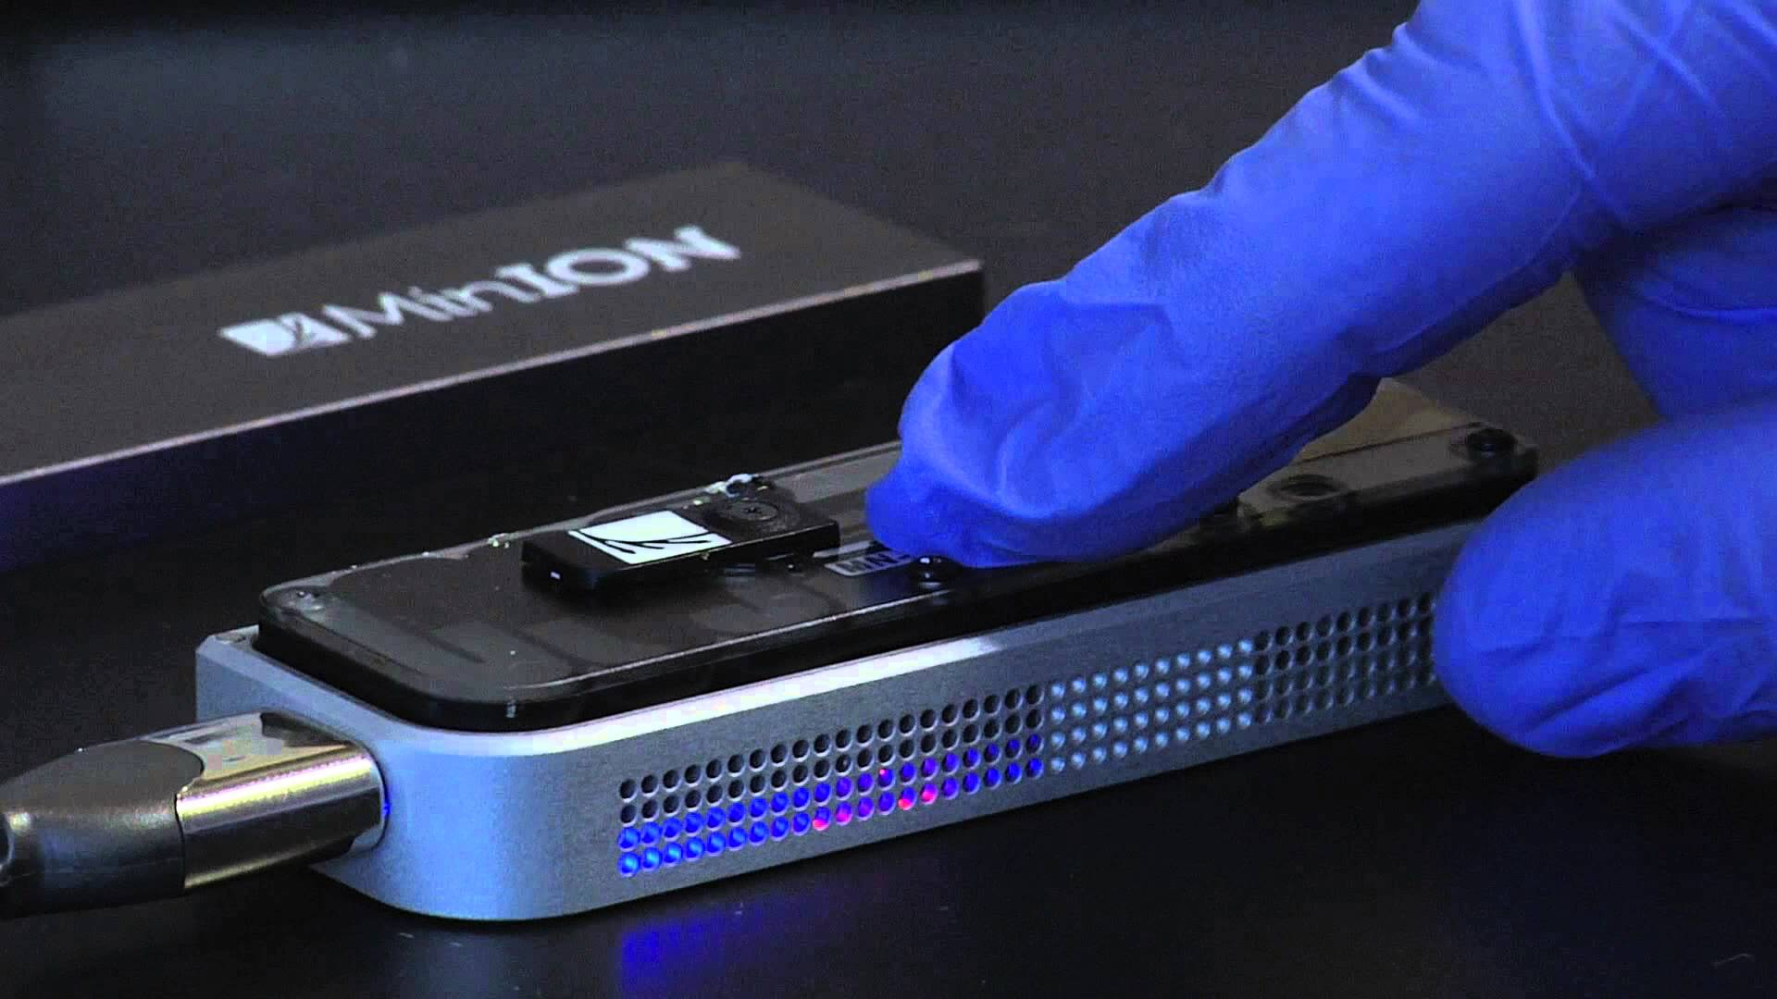
Bioinformatics
Even 10 years ago collecting low- to mid-volume data (e.g. DNA sequencing) was slow and expensive
Now – large scale data collection fast and inexpensive
DNA sequencing is quickly becoming an “assay” – performed by many researchers whose primary goal is not bioinformatics
We now need a balance between bioinformatics labs / core facilities and translating the skill set to researchers in all areas of bioscience
Illumina DNA Sequencer
Nanopore DNA Sequencer

Slide 28
Bioinformatics – Relative Costs
Sboner et al. 2011. The real cost of sequencing: higher than you think! Genome Biol. 12(8):125.
Next Generation Sequencing (NGS) – Low cost, high volume advanced sequencing methods, e.g. Solexa/Illumina massively parallel sequencing
Pre-NGS – High cost, low volume DNA sequencing based on the Sanger sequencing method

Slide 29
Bioinformatics
Bioinformatics can be…
Hypothesis testing using experimentally generated data
Data curation and knowledge integration
Data mining as part of experimental design
There are no ‘one size fits all’ analyses
“Pure” bioinformatics is rare – new algorithm or data schema development
Most bioinformatics is “applied” and highly collaborative
Bioinformaticians need to understand the biology and lab work
This course will survey a number of key applied bioinformatics questions, with an introduction to the underlying theory
The course emphasizes breadth instead of depth
Go deeper...
Bioinformatics 4th year thesis project
Co-Op in a Bioinformatics lab
Graduate school

Slide 30
Bioinformatics
Bioinformatics is one of the data sciences
data – actual measurements and observations
metadata – information on methods, observer ID, date time, etc.
software & algorithms
databases and data formats
computing hardware & networks
Publish and share your data or it might as well not exist!
Permanent identifiers are essential
Follow data and file format standards
Document and share your methods, software & workflows – this is important metadata
Love your data scientist – Biocurators are the underdogs of modern biological research

Slide 31
BioCuration & Databases
Burge et al. 2012. Biocurators and biocuration: surveying the 21st century challenges. Database Mar 20:bar059
One of the most important tools in bioinformatics today is the database
Primary – raw data – DNA sequence, protein structure, chemical structure, gene expression measurements, etc
Secondary – integration of many sources of primary data, often organism-specific (e.g. Drosophila DB) or area specific (e.g. drug-drug interaction DB)
Literature curation (human or automated) and higher-level conceptual organization of knowledge (e.g. ontologies) increasingly important

Slide 32
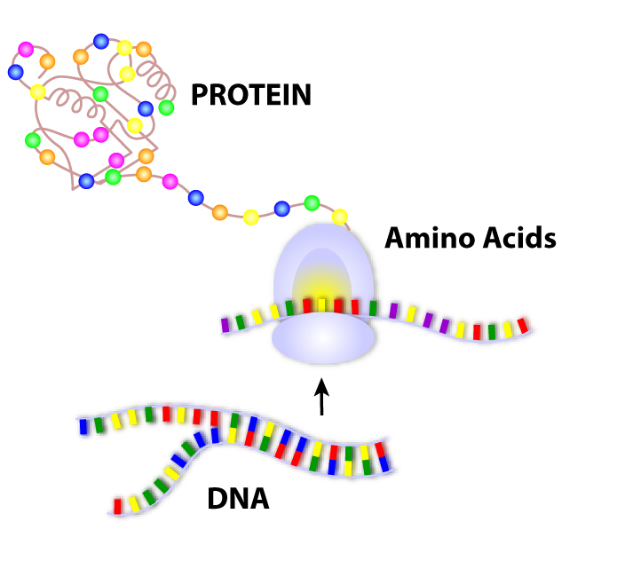
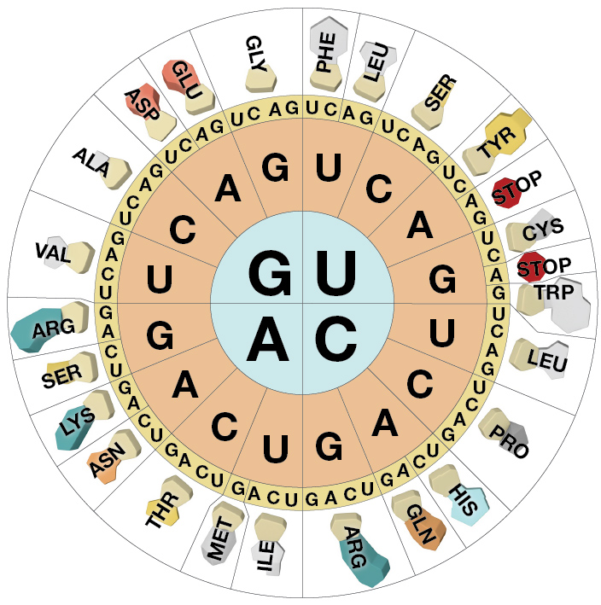
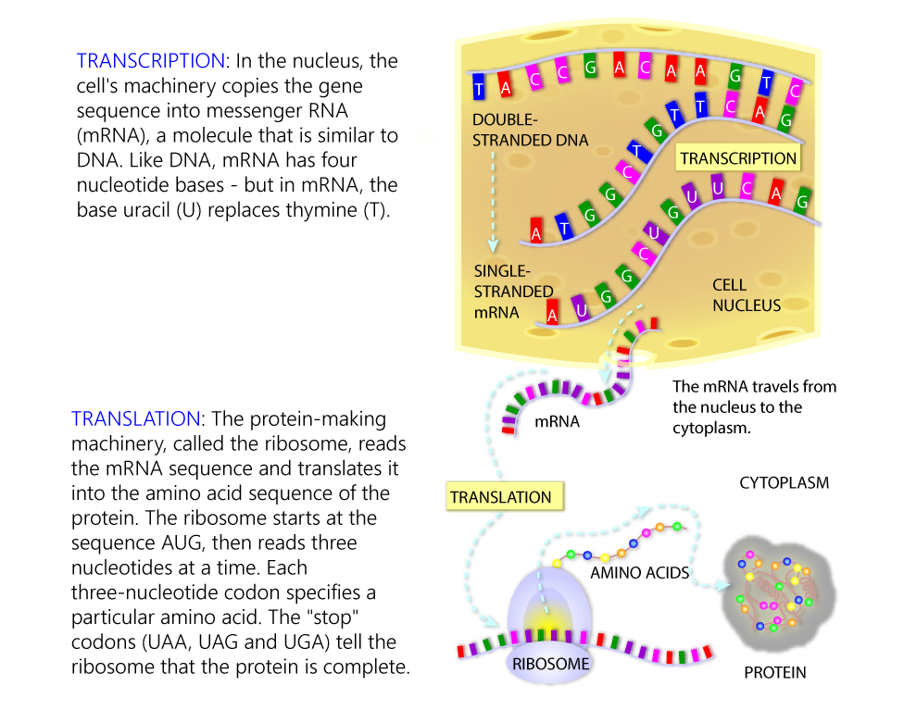
Next Week’s Lab focuses on Databases
Central Dogma
Images from "Genetic Science Learning Center, University of Utah, http://learn.genetics.utah.edu."
adenine and guanine are purines
cytosine, thymine, and uracil are pyrimidines

Slide 33
Next Week’s Lab focuses on Databases
Moore’s Law (computer processor speed doubles every 18 months) and Kryder’s Law (disk storage capacity doubles every 14 months) are critical to the future of biological research, see http://www.scientificamerican.com/article/kryders-law/
Will advances in DNA sequencing outstrip Moore’s and Kryder’s law?
NGS
Sboner et al. 2011. The real cost of sequencing: higher than you think! Genome Biol. 12(8):125.
Stein. 2010. The case for cloud computing in genome informatics. Genome Biol. 11(5):207.

Slide 34
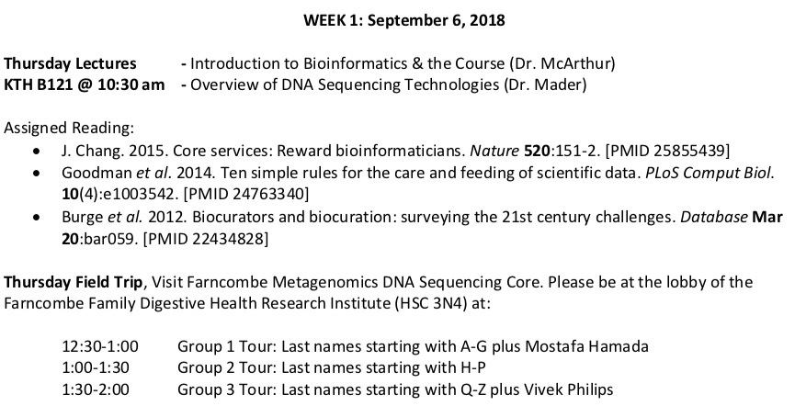
This week & next...
UPDATE

Slide 35
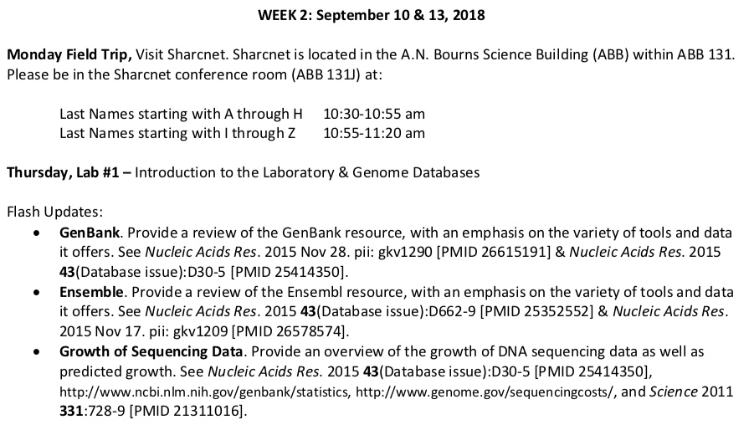
This week & next...
UPDATE
Carlos Barba Bazan
Ahmed Shoeib
Priska Taarea

